Slide 1

Using Luigi to control RNA-seq data processing pipeline
Chi Zhang, Ph.D
Senior Scientist, Bioinformatics
Eisai Inc
Final Project
CSCI-29, Fall 2019
Harvard Extension School

Slide 2
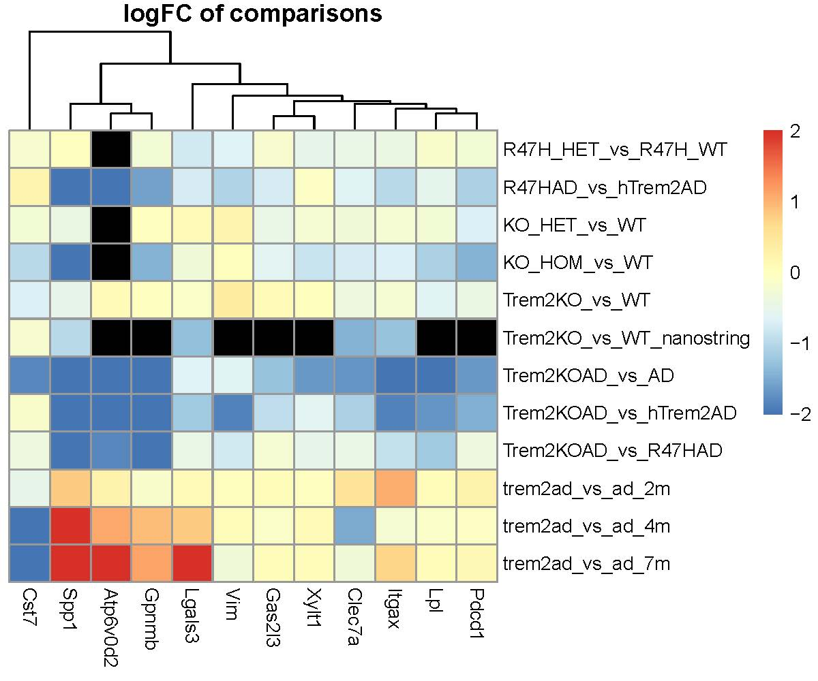
What’s RNA-seq?
RNA-seq uses Next-Generation-Sequencing (NGS) method to quantify the expression levels of all 60,000 genes for a sample.
By comparing the gene expression levels across samples, we can have an understanding of what’s changed before and after treatment
It is frequently used in the pharmaceutical industry to identify biomarkers for diseases and treatments.

Slide 3
RNA-seq Pipeline
The project can range from a couple to thousands of samples
Processing Pipeline
Build genome indexes using genome annotations.
Map sample sequences to human genome.
Summarize all sample files.
Preprocess to remove non-expressing genes. Visualize sample quality.
A commonly used solution is to use shell scripts containing for loops to batch submit all samples. However, we will still need to wait for the samples to be quantified before manually executing the next step.
I built this pipeline to provide full automation for RNA-seq processing. All we need to do is to specify where all the input files are and run. If there is some run failures, luigi will tell us which job failed so the user can easily make necessary changes.

Slide 4
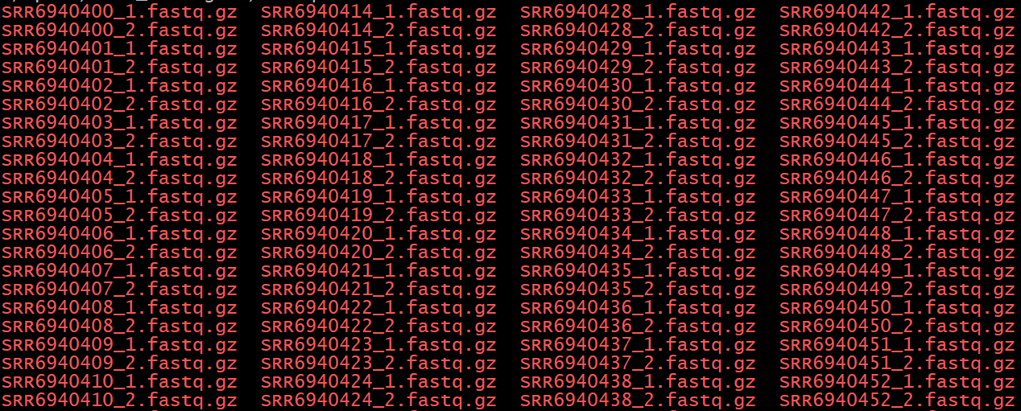
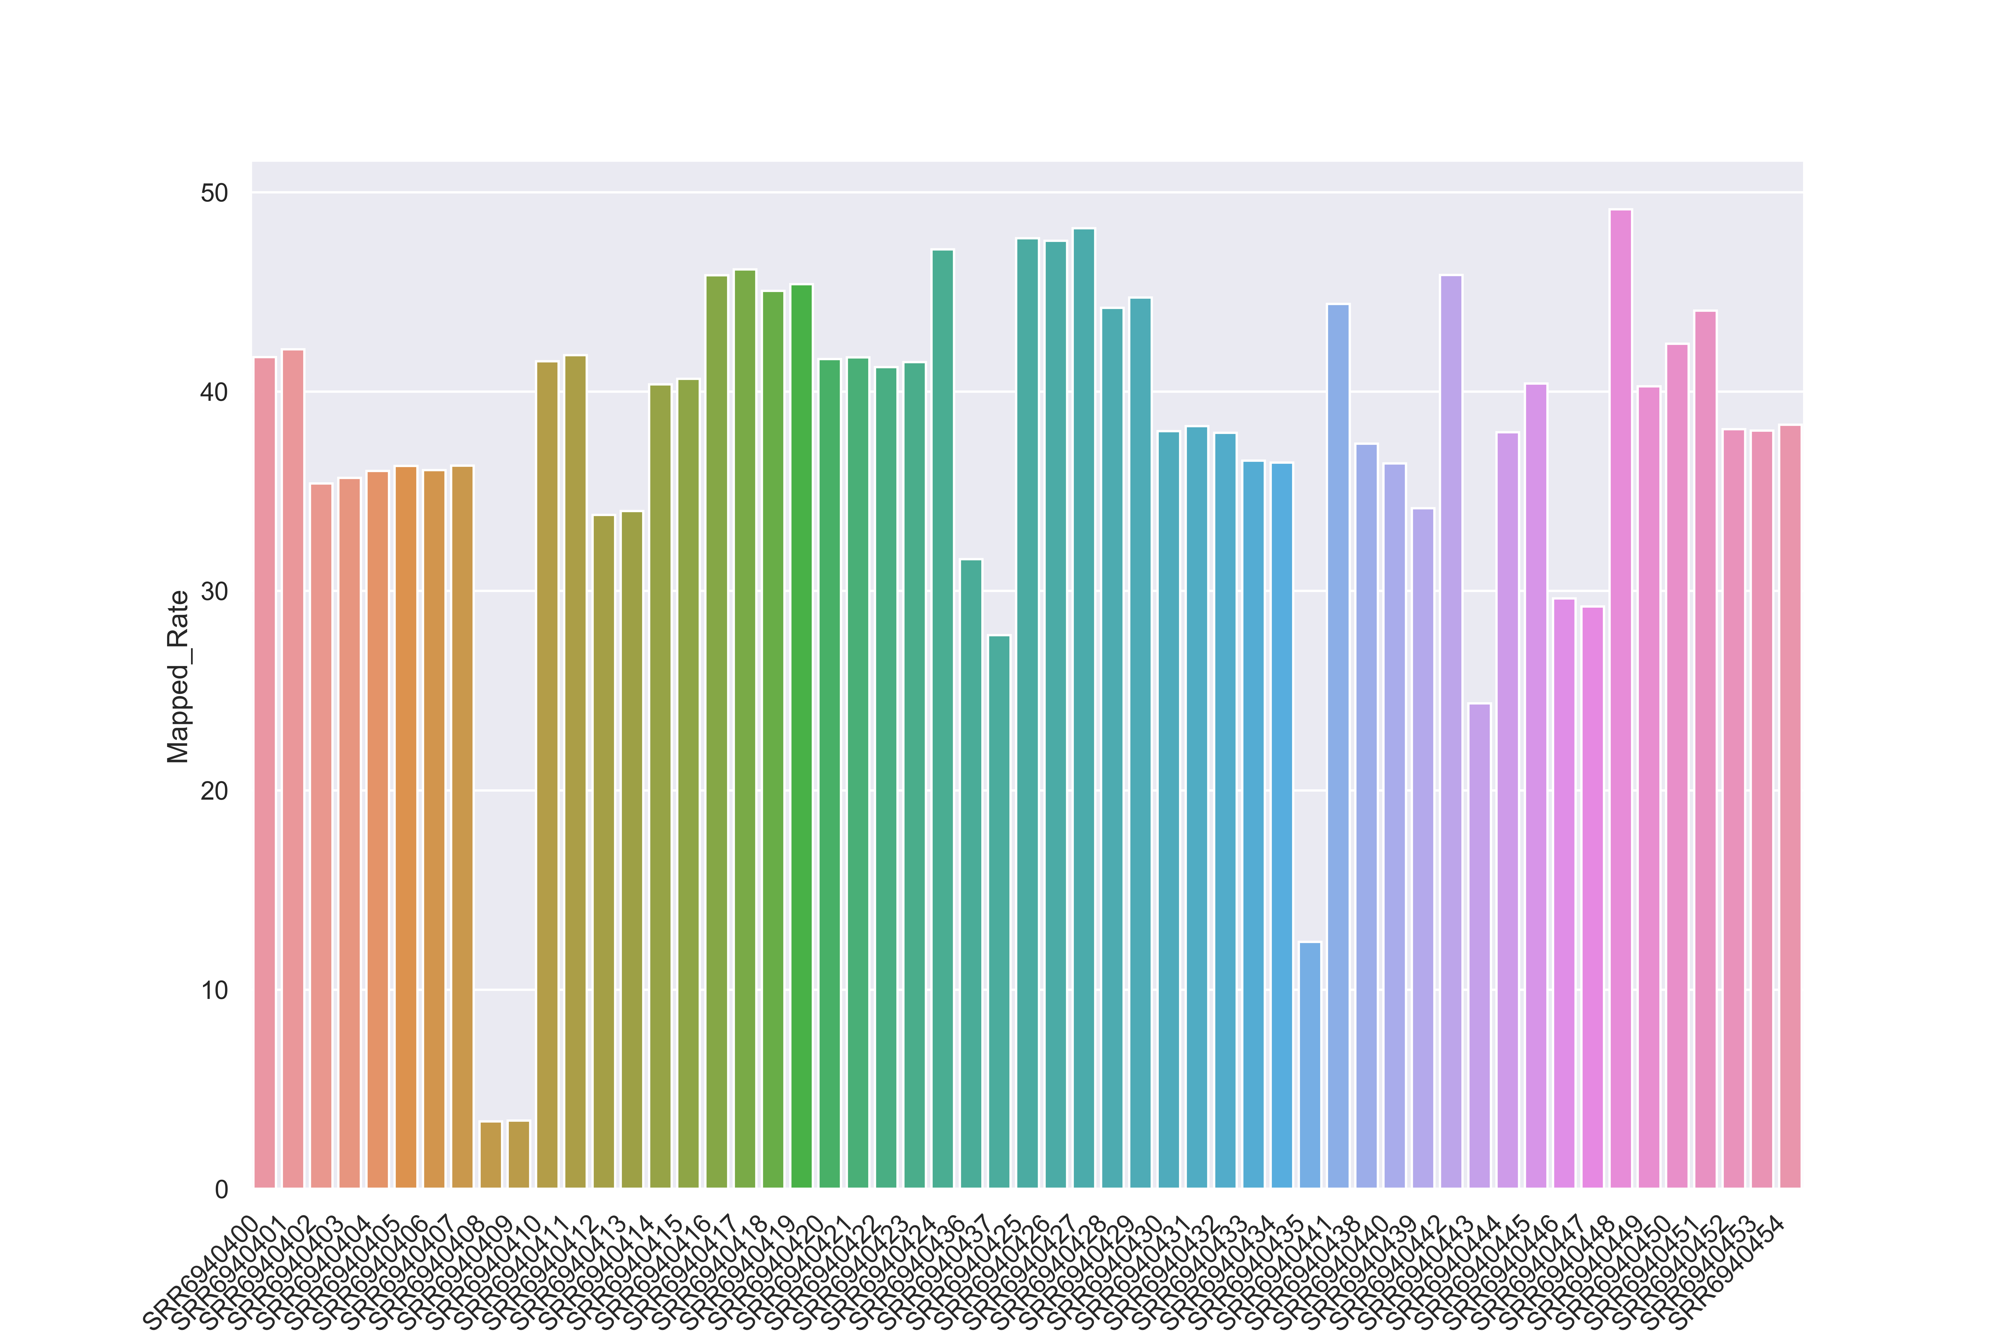
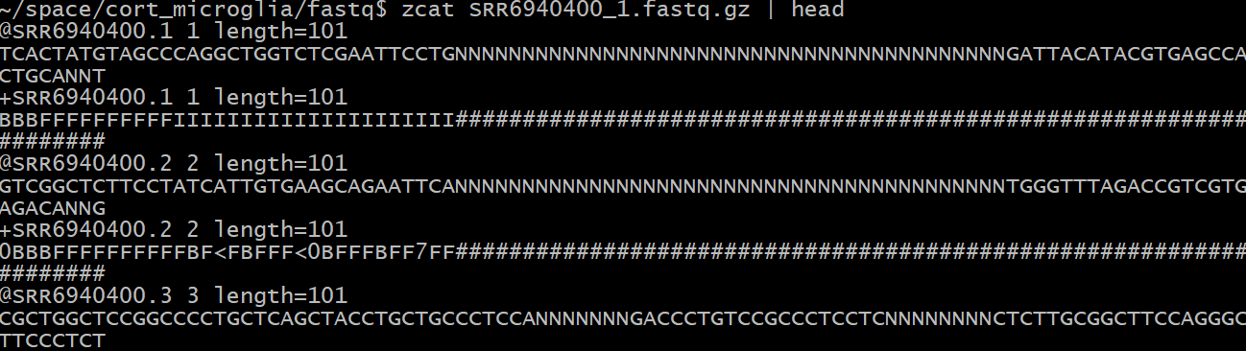
Overview: Inputs and outputs of pipeline
Input: Sample sequences
Output: QC and Counts table
gene_name | SRR6940400 | SRR6940401 | SRR6940402 | SRR6940403
5S_rRNA | 5 | 7.46473 | 15.87387 | 11.33042
5_8S_rRNA | 0 | 0 | 0 | 0
7SK | 1166.602 | 1539.49 | 595.3314 | 486.2188
A1BG | 112.4053 | 71.6409 | 108.1643 | 76.5447
A1BG-AS1 | 49.49673 | 52.08008 | 33.42115 | 22.6428
A1CF | 15.02241 | 9.019261 | 15.02231 | 12.0545
A2M | 35188.52 | 27924.49 | 23316.32 | 17498.9

Slide 5
Overview: workflow
Transcriptome annotation file
Transcriptome fasta file
Salmon Index folder
Salmon
Index
Sample1 expression table
Sample1 sequence fastq file
Pandas
Seaborn
Perl script
Salmon
Quant
Sample2 expression table
All sample summary
Sample2 sequence fastq file
…
SampleN sequence fastq file
SampleN expression table

Slide 6
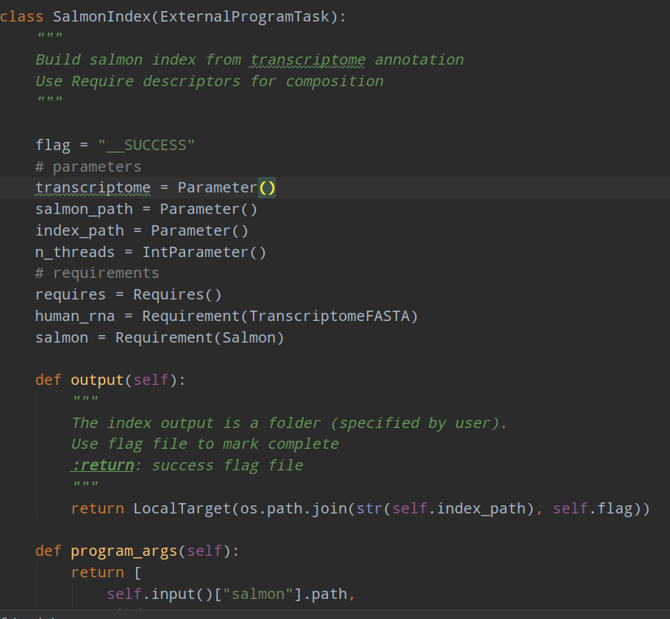
Luigi Tasks: Index
Salmon
ExternalTask
Check program exist
SalmonIndex
Task
Build Index
TranscriptomeFASTA
ExternalTask
Check file exists
Requirement Descriptor composition
Flag success after completion

Slide 7
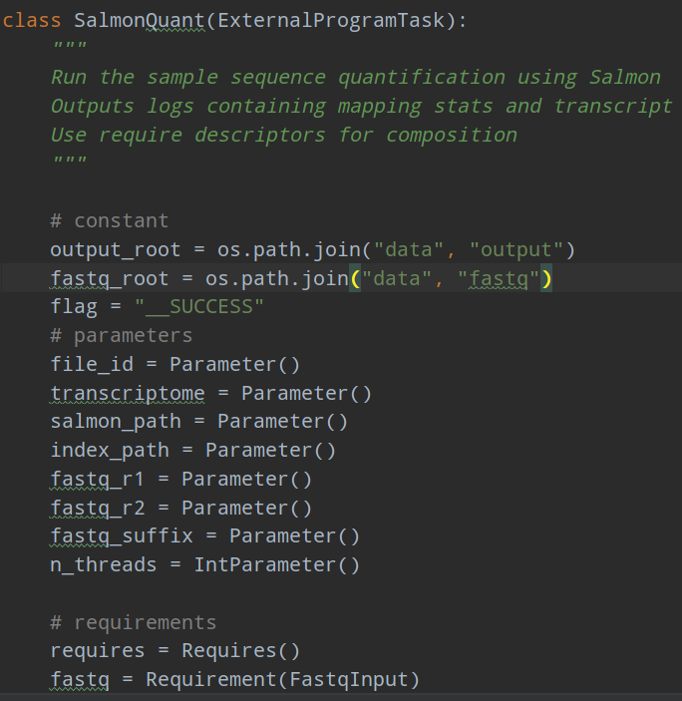
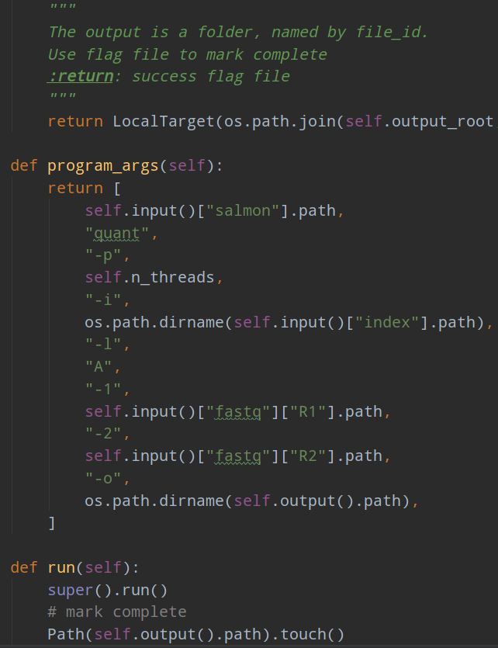
Luigi Tasks: Quantify
Salmon
ExternalTask
Check program exist
SalmonQuant
ExternalProgramTask
Quantify gene expression
FASTQInput
ExternalTask
Check file exists
SalmonIndex
Task
Build Index

Slide 8
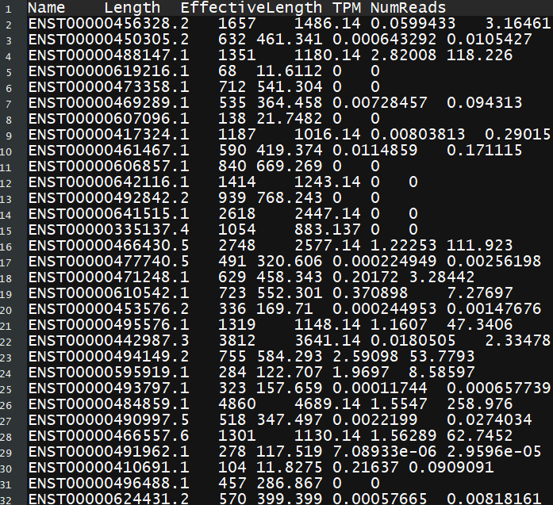
Luigi Tasks: Quantify
Salmon
ExternalTask
Check program exist
SalmonQuant
ExternalProgramTask
Quantify gene expression
FASTQInput
ExternalTask
Check file exists
SalmonIndex
Task
Build Index
One sample per file

Slide 9
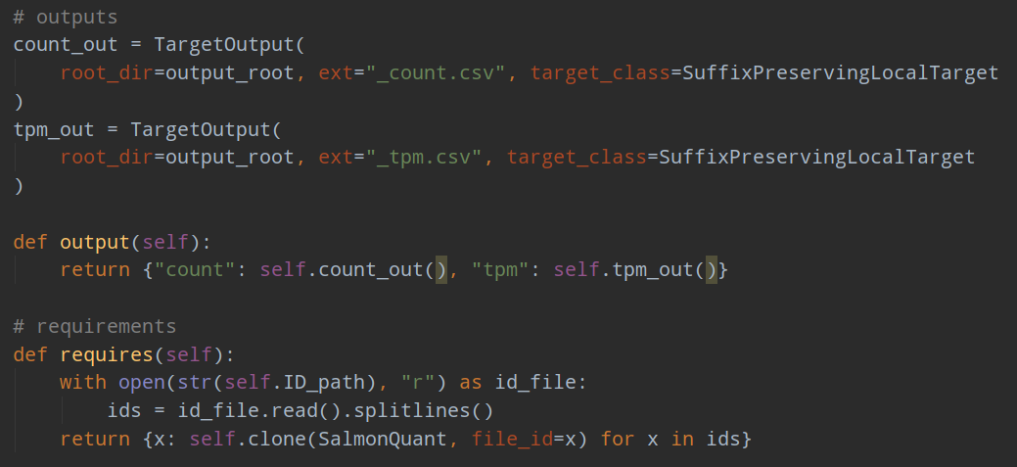
Luigi Tasks: Summarize
SalmonQuant
ExternalProgramTask
Quantify gene expression
SummarizeMapping
ExternaProgramlTask
Get mapping QC
SalmonQuant
ExternalProgramTask
Quantify gene expression
SummarizeCount
Task
Get counts and tpm table
SalmonQuant
ExternalProgramTask
Quantify gene expression
Batch require
Output Descriptor

Slide 10
Luigi Tasks: Summarize
transcript_ID | SRR6940400 | SRR6940401 | SRR6940402 | SRR6940403 | SRR6940404 | SRR6940405
ENST00000456328.2 | 30.6969 | 27.0049 | 25.6706 | 16.4826 | 17.0259 | 16.4441
ENST00000450305.2 | 0 | 0 | 0 | 0 | 0 | 0
ENST00000488147.1 | 141.643 | 92.6522 | 63.2951 | 62.4215 | 87.9552 | 55.5739
ENST00000619216.1 | 0 | 0 | 0 | 0 | 0 | 0
ENST00000473358.1 | 0 | 0 | 0 | 0 | 0 | 0
ENST00000469289.1 | 0 | 0 | 0 | 1.02309 | 0 | 0
ENST00000607096.1 | 0 | 0 | 0 | 0 | 0 | 0
ENST00000417324.1 | 0 | 0 | 0 | 0.089388 | 0 | 0
ENST00000461467.1 | 37.0488 | 17.9204 | 43.7439 | 32.6434 | 43.3825 | 25.1489
ENST00000606857.1 | 0 | 0 | 0 | 1 | 0 | 0
ENST00000642116.1 | 0 | 0 | 0 | 0 | 0 | 0
ENST00000492842.2 | 1 | 2 | 1 | 0 | 0 | 0
ENST00000641515.1 | 0 | 1.55655 | 0 | 0 | 0 | 0
ENST00000335137.4 | 0 | 0.222117 | 0 | 0 | 0 | 0
ENST00000466430.5 | 59.2709 | 33.8226 | 46.2818 | 16.7093 | 19.6444 | 6.57742
ENST00000477740.5 | 0 | 0 | 0 | 0 | 0 | 0
ENST00000471248.1 | 7.86672 | 11.1442 | 9.06342 | 9.17123 | 22.919 | 6.69799
ENST00000610542.1 | 2.83742 | 10.246 | 10 | 2.15104 | 0 | 0
ENST00000453576.2 | 0 | 0 | 0 | 1.96356 | 4.35338 | 1.32073
ENST00000495576.1 | 5.85878 | 6.20162 | 3.70267 | 18.2404 | 3.51284 | 4.37391
ENST00000442987.3 | 162.93 | 127.832 | 199.444 | 133.336 | 251.116 | 197.69
ENST00000494149.2 | 25.3397 | 32.5211 | 126.879 | 66.0557 | 118.769 | 78.5791
ENST00000595919.1 | 4.73878 | 6 | 19.987 | 10.3388 | 34.5172 | 12.0874
ENST00000493797.1 | 0 | 0 | 0 | 0 | 0 | 0
SalmonQuant
ExternalProgramTask
Quantify gene expression
All samples on the columns
SummarizeMapping
ExternaProgramlTask
Get mapping QC
SalmonQuant
ExternalProgramTask
Quantify gene expression
Lots of genes with no expression
SummarizeCount
Task
Get counts and tpm table
SalmonQuant
ExternalProgramTask
Quantify gene expression
Cryptic ID name
Each gene can have multiple transcripts

Slide 11
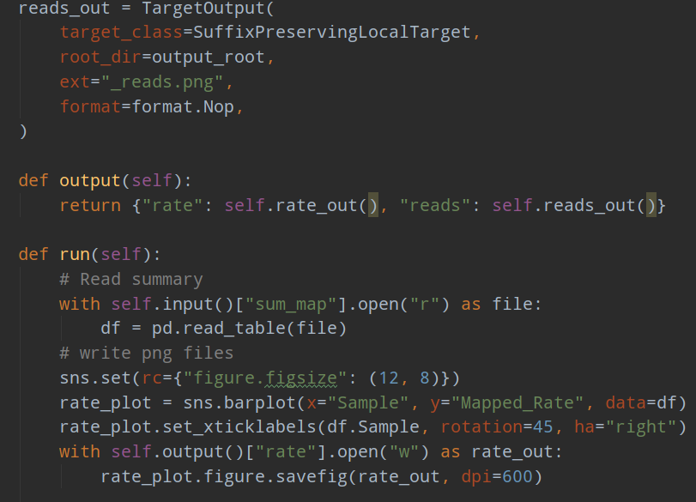
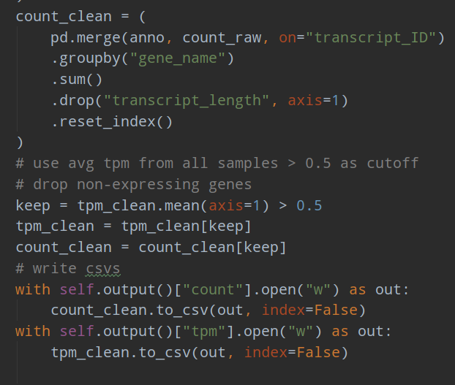
Luigi Tasks: Preprocess
SuffixPreserving Atomic output
SummarizeMapping
ExternaProgramlTask
Get mapping QC
MapFigure
Task
Get QC Plots
SummarizeCount
Task
Get counts and tpm table
CleanCounts
Task
Sum by gene
Filter expression
AnnotationFile
ExternalTask
Check file exist

Slide 12
Luigi Tasks: Preprocess
SummarizeMapping
ExternaProgramlTask
Get mapping QC
MapFigure
Task
Get QC Plots
QC issues
SummarizeCount
Task
Get counts and tpm table
Readable name
One value for each gene
Non-expressing genes removed
CleanCounts
Task
Sum by gene
Filter expression
gene_name | SRR6940400 | SRR6940401 | SRR6940402 | SRR6940403
5S_rRNA | 5 | 7.46473 | 15.87387 | 11.33042
5_8S_rRNA | 0 | 0 | 0 | 0
7SK | 1166.602 | 1539.49 | 595.3314 | 486.2188
A1BG | 112.4053 | 71.6409 | 108.1643 | 76.5447
A1BG-AS1 | 49.49673 | 52.08008 | 33.42115 | 22.6428
A1CF | 15.02241 | 9.019261 | 15.02231 | 12.0545
A2M | 35188.52 | 27924.49 | 23316.32 | 17498.9
AnnotationFile
ExternalTask
Check file exist

Slide 13
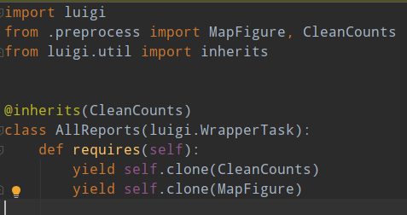
Luigi tasks: Wrapup
MapFigure
Task
Get QC Plots
AllReports
WrapperTask
Get all reports
CleanCounts
Task
Sum by gene
Filter expression
New trick: WrapperTask, wrapper to pull multiple independent tasks together
New trick: luigi inherit decorator, inherits parameters only

Slide 14
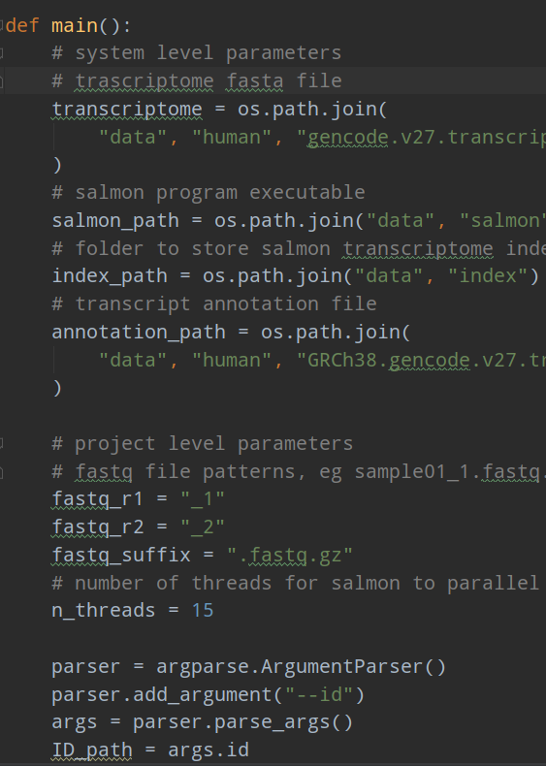
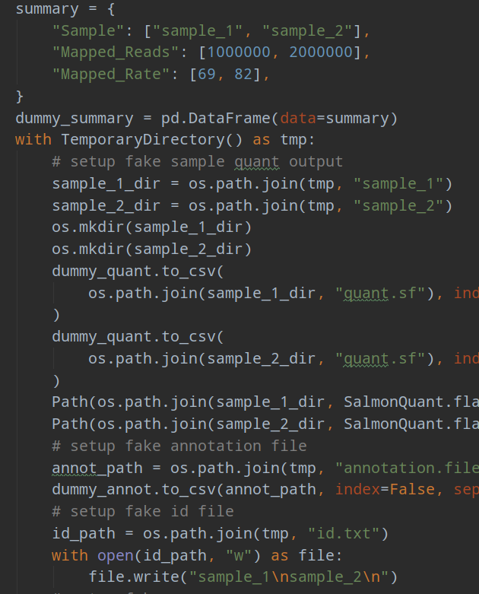
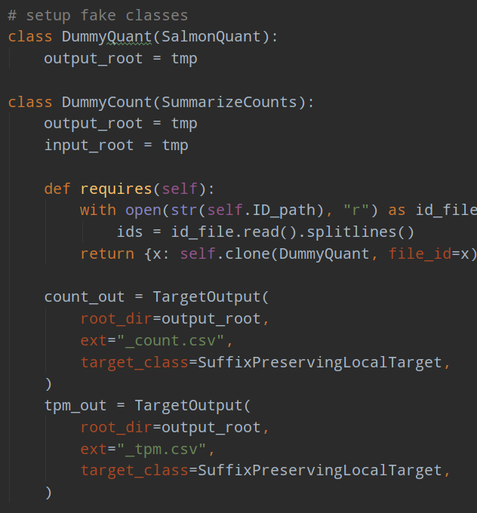
cli.py and unit tests

Slide 15
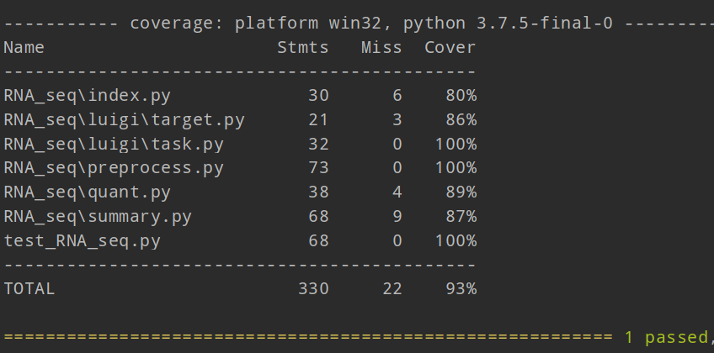
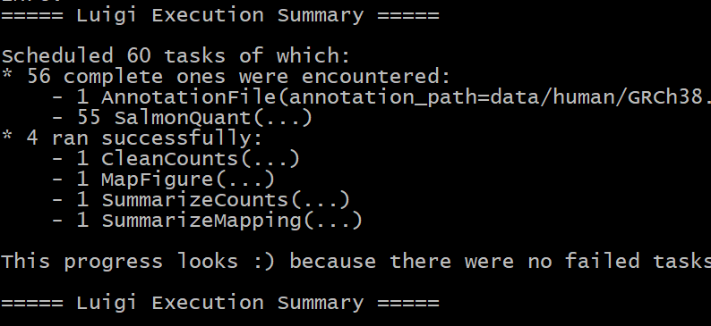
cli.py and unit tests
Ran on 55 samples with success
Test coverage looks good

Slide 16
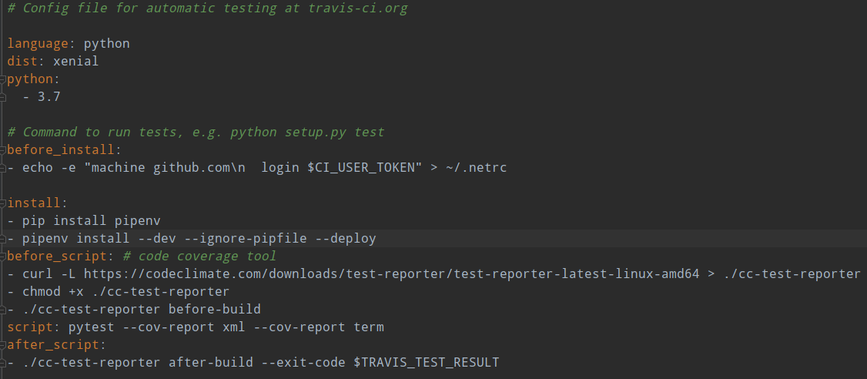
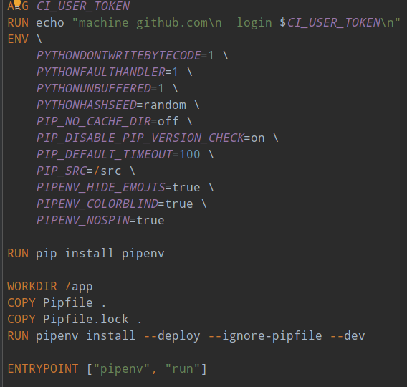
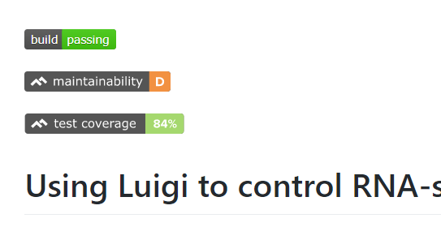
Docker and Travis integration
Travis implemented with just one stage

Slide 17
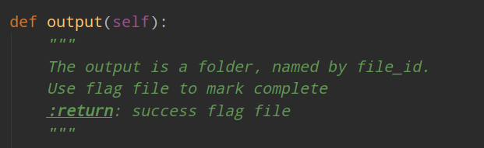
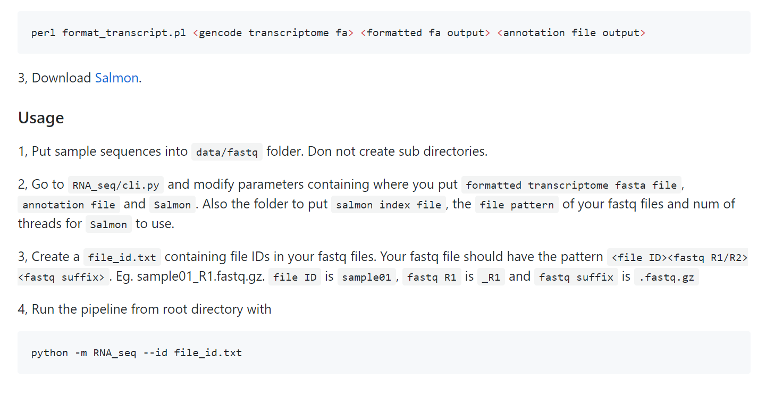
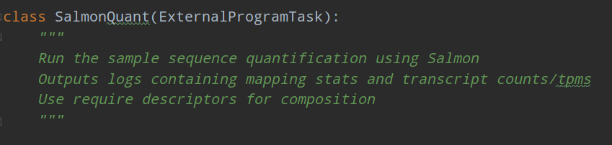
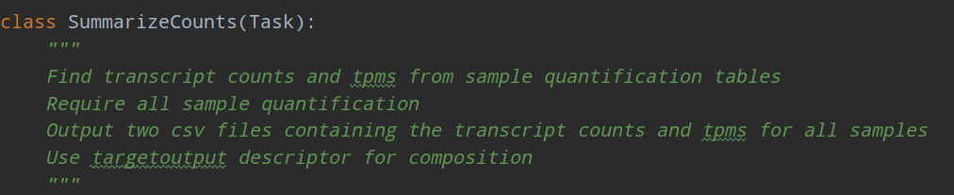
Documentation and README
All code accessible via GitHub
https://github.com/csci-e-29/2019fa-final-project-zhangchipku

